Slide 1

Introduction to
Reinforcement
Learning
Presentation: Baekryun Seong
2024.05.09

Slide 2
Reinforcement Learning
Conditional Probability
Markov Decision Process
Policy
Value Function
Table of Contents

Slide 3
Ch 1.1
Reinforcement
Learning

Slide 4
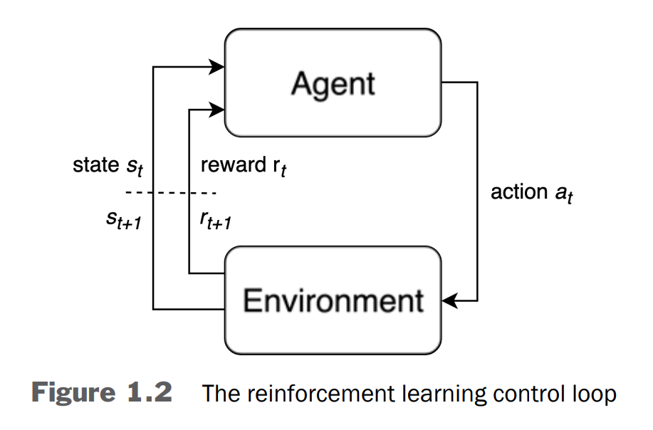
Ch 1.1 Reinforcement Learning - Control Loop
Environment generates State
Agent selects Action
Environment accepts the action and returns the next state and a reward.
When the cycle of (state → action → reward) completes, we say that one time step has passed.

Slide 5
Ch 1.1 Reinforcement Learning - Control Loop
Policy is an agent's action-producing function, which maps states to a actions.
RL Problems have an objective, which is the sum of rewards received by an agent.
An agent uses the reward signals it receives to reinforce good actions.

Slide 6
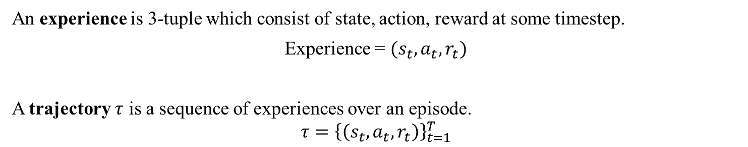
Ch 1.1 Reinforcement Learning
An experience is 3-tuple which consist of state, action, reward at some timestep.
Experience = $(s_{t},a_{t},r_{t})$
A trajectory $τ$ is a sequence of experiences over an episode.
$$τ={\left\{\left(s_{t},a_{t},r_{t}\right)\right\}}_{t=1}^{T}$$

Slide 7
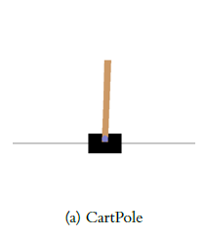
Ch 1.1 Reinforcement Learning - Environment Example
Objective: Keep the pole upright for 200 time steps.
State: An array of length 4 which represents: [cart position, cart velocity, pole angle, pole angular velocity]. For example, [-0.034, 0.032, -0.031, 0.036].
Action: An integer, either 0 to move the cart a fixed distance to the left, or 1 to move the cart a fixed distance to the right.
Reward: +1 for every time step the pole remains upright.
Termination: When the pole falls over (greater than 12 degrees from vertical), or when the cart moves out of the screen, or when the maximum time step of 200 is reached.

Slide 8
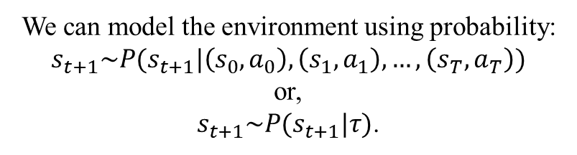

Ch 1.1 Reinforcement Learning - Formal Definitions and Transition Probability
$s_{t}∈𝒮$ is the state, $𝒮$ is the state space.
$a_{t}∈𝒜$ is the action, $𝒜$is the action space.
$r_{t}∈ℛ(s_{t}, a_{t}, s_{t+1})$ is the reward, $ℛ$is the reward function.
We can model the environment using probability:
$$s_{t+1}\sim P(s_{t+1}|\left(s_{0},a_{0}\right),\left(s_{1},a_{1}\right),…,\left(s_{T},a_{T}\right))$$
or,
$s_{t+1}\sim P(s_{t+1}|τ)$.

Slide 9
Ch1.2
Markov Decision Process

Slide 10
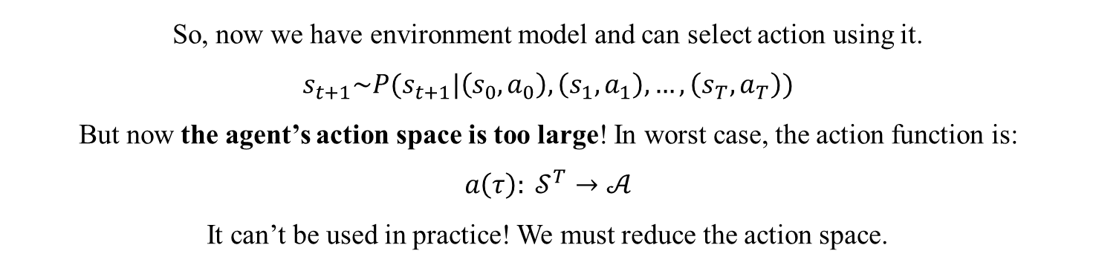
Ch 1.2 Markov Decision Process – Limitation of Transition Probability over Full Trajectory.
So, now we have environment model and can select action using it.
$$s_{t+1}\sim P(s_{t+1}|\left(s_{0},a_{0}\right),\left(s_{1},a_{1}\right),…,\left(s_{T},a_{T}\right))$$
But now the agent’s action space is too large! In worst case, the action function is:
$$a\left(τ\right): 𝒮^{T}→𝒜$$
It can’t be used in practice! We must reduce the action space.

Slide 11


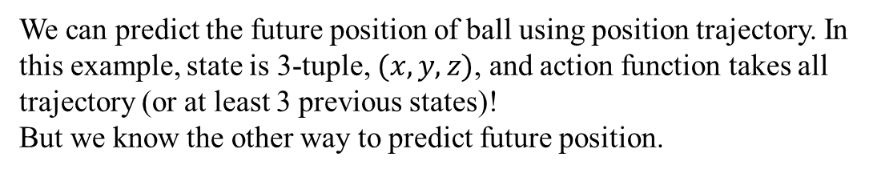
Ch 1.2 Markov Decision Process – Markov Example
We can predict the future position of ball using position trajectory. In this example, state is 3-tuple, $(x,y,z)$, and action function takes all trajectory (or at least 3 previous states)!
But we know the other way to predict future position.

Slide 12
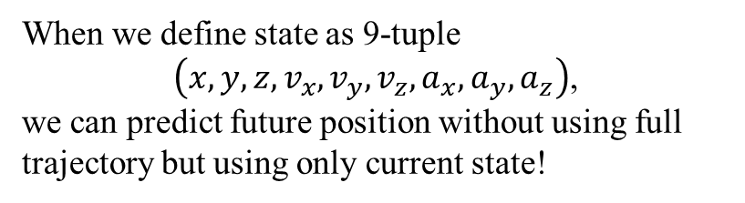
Ch 1.2 Markov Decision Process – Markov Example
When we define state as 9-tuple
$\left(x,y,z,v_{x},v_{y},v_{z},a_{x},a_{y},a_{z}\right)$,
we can predict future position without using full trajectory but using only current state!
v
a
x

Slide 13

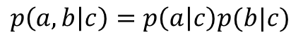
Ch 1.2 Markov Decision Process – Conditional Probability
Now we define conditional probability as
$a is conditionally independent to b given c≡p\left(a | b,c\right)=p\left(a | c\right)$.
We can draw a directed graph representing this:
$$p\left(a,b | c\right)=p\left(a | c\right)p(b|c)$$

Slide 14
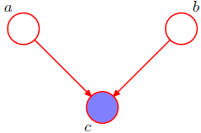
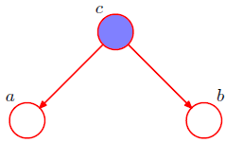
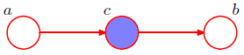
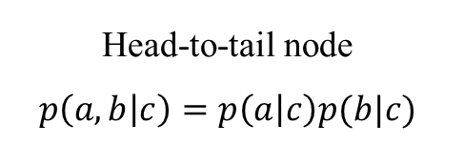
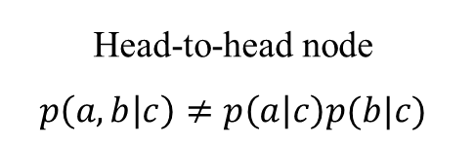
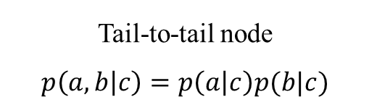
Ch 1.2 Markov Decision Process – Conditional Probability
Tail-to-tail node
$$p\left(a,b | c\right)=p\left(a | c\right)p(b|c)$$
Head-to-head node
$$p\left(a,b | c\right)≠p\left(a | c\right)p(b|c)$$
Head-to-tail node
$$p\left(a,b | c\right)=p\left(a | c\right)p(b|c)$$

Slide 15
Ch 1.2 Markov Decision Process – Conditional Probability
Tail-to-tail node
$$p\left(a,b | c\right)=p\left(a | c\right)p(b|c)$$
Head-to-head node
$$p\left(a,b | c\right)≠p\left(a | c\right)p(b|c)$$
Head-to-tail node
$$p\left(a,b | c\right)=p\left(a | c\right)p(b|c)$$

Slide 16
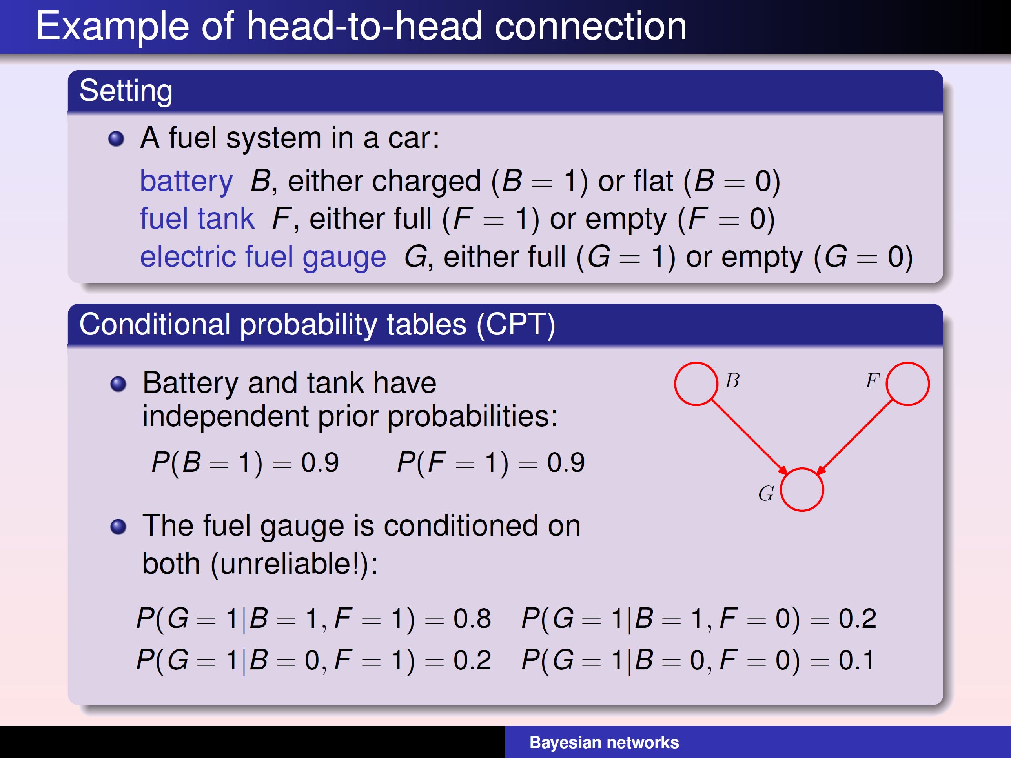
Ch 1.2 Markov Decision Process – Conditional Probability in Head-to-head node

Slide 17
Ch 1.2 Markov Decision Process – Conditional Probability in Head-to-head node

Slide 18
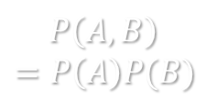
Ch 1.2 Markov Decision Process – Conditional Probability in Diagram
S
B
$$P\left(A,B\right)$$
$$=P\left(A\right)P(B)$$
A

Slide 19
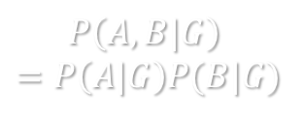
Ch 1.2 Markov Decision Process – Conditional Probability in Diagram
S
B
G
$$P\left(A,B|G\right)$$
$$=P\left(A|G\right)P(B|G)$$
A

Slide 20
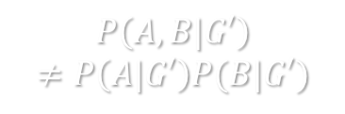
Ch 1.2 Markov Decision Process – Conditional Probability in Diagram
S
B
G
$$P\left(A,B|G′\right)$$
$$≠P\left(A|G′\right)P(B|G′)$$
A

Slide 21
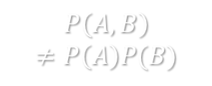
Ch 1.2 Markov Decision Process – Conditional Probability in Diagram
S
B
$$P\left(A,B\right)$$
$$≠P\left(A\right)P(B)$$
A

Slide 22
Ch 1.2 Markov Decision Process – Conditional Probability in Diagram
S
B
G
$$P\left(A,B|G\right)$$
$$=P\left(A|G\right)P(B|G)$$
A

Slide 23
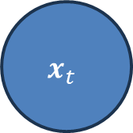
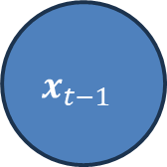
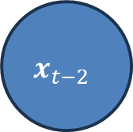
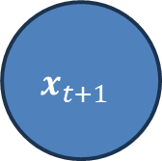
Ch 1.2 Markov Decision Process – Conditional Probability Example
Assume we need 3 states ${\left\{x_{t},y_{t},z_{t}\right\}}_{t^{′}=t−3}^{t}$ to predict next state.
$$x_{t−1}$$
$$x_{t}$$
$$x_{t−2}$$
$$x_{t+1}$$

Slide 24
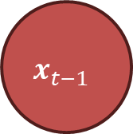

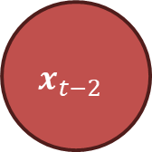
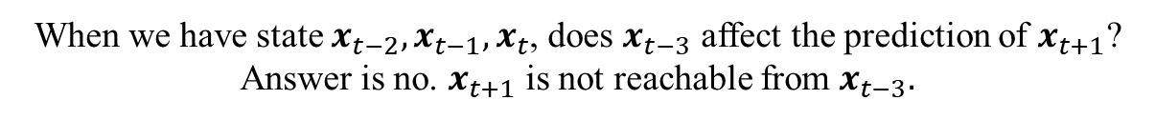
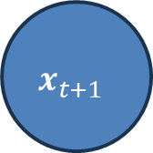
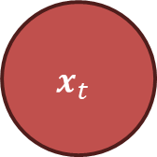
Ch 1.2 Markov Decision Process – Conditional Probability Example
When we have state $x_{t−2},x_{t−1},x_{t}$, does $x_{t−3}$ affect the prediction of $x_{t+1}$?
Answer is no. $x_{t+1}$ is not reachable from $x_{t−3}.$
$$x_{t−1}$$
$$x_{t−2}$$
$$x_{t}$$
$$x_{t−3}$$
$$x_{t+1}$$

Slide 25
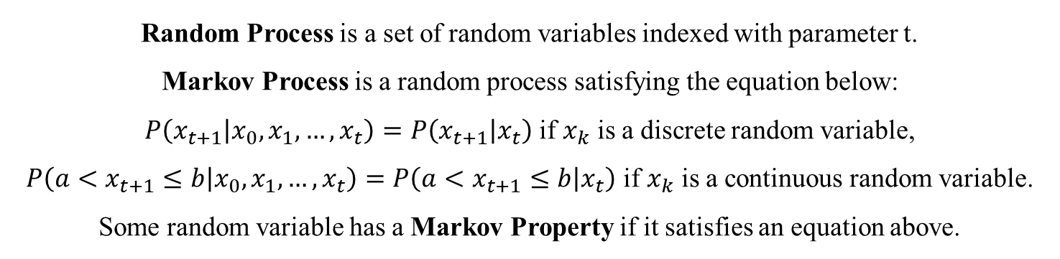
Ch 1.2 Markov Decision Process – Probability Process and Markov Process
Random Process is a set of random variables indexed with parameter t.
Markov Process is a random process satisfying the equation below:
$P\left(x_{t+1} | x_{0},x_{1},…,x_{t}\right)=P\left(x_{t+1} | x_{t}\right)$ if $x_{k}$ is a discrete random variable,
$P\left(a<x_{t+1}≤b | x_{0},x_{1},…,x_{t}\right)=P\left(a<x_{t+1}≤b | x_{t}\right)$ if $x_{k}$ is a continuous random variable.
Some random variable has a Markov Property if it satisfies an equation above.

Slide 26
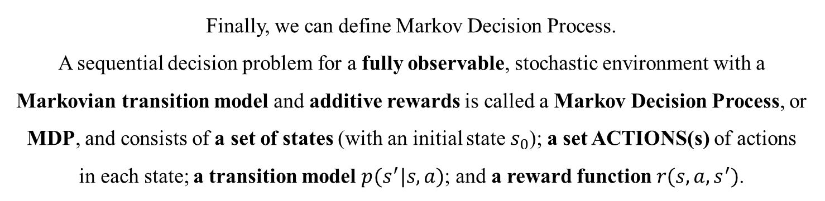
Ch 1.2 Markov Decision Process – Markov Decision Process
Finally, we can define Markov Decision Process.
A sequential decision problem for a fully observable, stochastic environment with a Markovian transition model and additive rewards is called a Markov Decision Process, or MDP, and consists of a set of states (with an initial state $s_{0}$); a set ACTIONS(s) of actions
in each state; a transition model $p(s^{′}|s,a)$; and a reward function $r(s,a,s^{′})$.

Slide 27
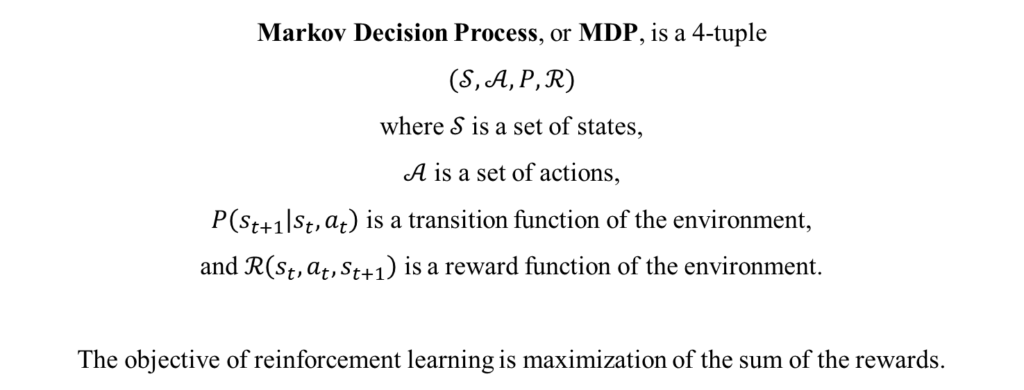
Ch 1.2 Markov Decision Process – Markov Decision Process Formal Definition
Markov Decision Process, or MDP, is a 4-tuple
$$(𝒮,𝒜,P,ℛ)$$
where$𝒮$ is a set of states,
$𝒜$ is a set of actions,
$P\left(s_{t+1} | s_{t},a_{t}\right)$ is a transition function of the environment,
and $ℛ\left(s_{t},a_{t},s_{t+1}\right)$ is a reward function of the environment.
The objective of reinforcement learning is maximization of the sum of the rewards.

Slide 28
Ch 1.2 Markov Decision Process – Markov Decision Process Diagram

Slide 29
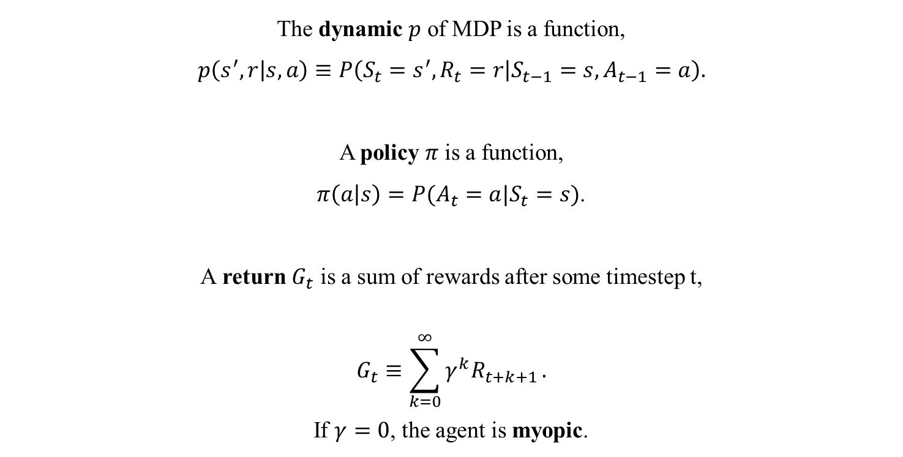
Ch 1.2 Markov Decision Process – Dynamic and Return of MDP
The dynamic $p$ of MDP is a function,
$$p\left(s^{′},r | s,a\right)≡P\left(S_{t}=s^{′},R_{t}=r | S_{t−1}=s,A_{t−1}=a\right).$$
A policy $π$ is a function,
$π\left(a | s\right)=P(A_{t}=a|S_{t}=s)$.
A return $G_{t}$ is a sum of rewards after some timestep t,
$$G_{t}≡\sum_{k=0}^{∞}{γ^{k}R_{t+k+1}}.$$
If $γ=0$, the agent is myopic.

Slide 30
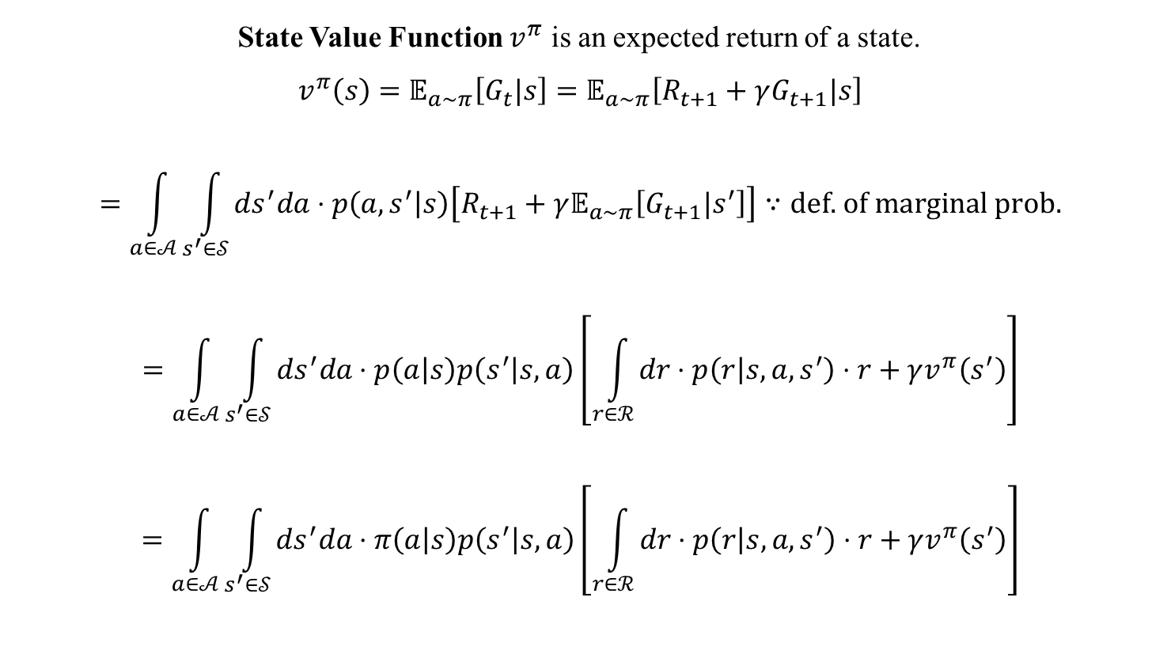
Ch 1.2 Markov Decision Process – Value Function
State Value Function $v^{π}$ is an expected return of a state.
$$v^{π}\left(s\right)=𝔼_{a\sim π}\left[G_{t}|s\right]=𝔼_{a\sim π}\left[R_{t+1}+γG_{t+1}|s\right]$$
$$=\int_{a∈𝒜}^{ }{\int_{s^{′}∈𝒮}^{ }{ds^{′}da⋅p\left(a, s^{′} | s\right)\left[R_{t+1}+γ𝔼_{a\sim π}\left[G_{t+1}|s^{′}\right]\right]}}∵\text{def}\text{. }\text{of} \text{marginal} \text{prob}\text{.}$$
$$=\int_{a∈𝒜}^{ }{\int_{s^{′}∈𝒮}^{ }{ds^{′}da⋅p\left(a | s\right)p\left(s^{′} | s,a\right)\left[\int_{r∈ℛ}^{ }{dr⋅p\left(r | s,a,s^{′}\right)⋅r}+γv^{π}\left(s^{′}\right)\right]}}$$
$$=\int_{a∈𝒜}^{ }{\int_{s^{′}∈𝒮}^{ }{ds^{′}da⋅π\left(a | s\right)p\left(s^{′} | s,a\right)\left[\int_{r∈ℛ}^{ }{dr⋅p\left(r | s,a,s^{′}\right)⋅r}+γv^{π}\left(s^{′}\right)\right]}}$$

Slide 31
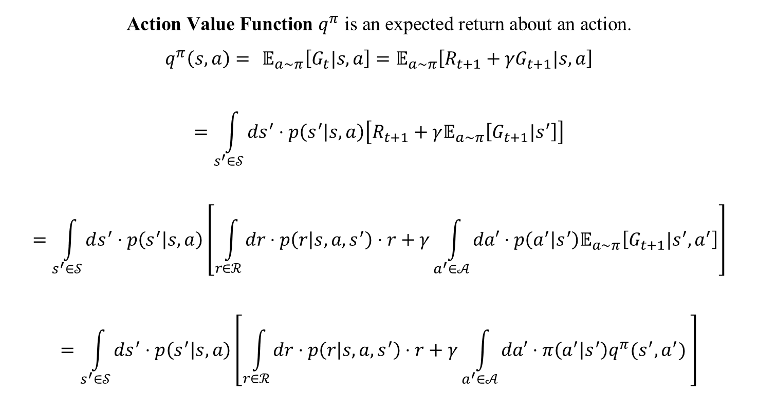
Ch 1.2 Markov Decision Process – Value Function
$$\text{A}\text{ction} \text{Value} \text{Function} q^{π} \text{is} \text{an} \text{expected} \text{return} \text{about} \text{an} \text{action}\text{.}$$
$$q^{π}\left(s,a\right)= 𝔼_{a\sim π}\left[G_{t}|s,a\right]=𝔼_{a\sim π}\left[R_{t+1}+{γG}_{t+1}|s,a\right]$$
$$=\int_{s^{′}∈𝒮}^{ }{ds^{′}⋅p\left(s^{′} | s,a\right)\left[R_{t+1}+γ𝔼_{a\sim π}\left[G_{t+1}|s^{′}\right]\right]}$$
$$=\int_{s^{′}∈𝒮}^{ }{ds^{′}⋅p\left(s^{′} | s,a\right)\left[\int_{r∈ℛ}^{ }{dr⋅p\left(r | s,a,s^{′}\right)⋅r}+γ\int_{a^{′}∈𝒜}^{ }{da′⋅p\left(a^{′} | s^{′}\right)𝔼_{a\sim π}\left[G_{t+1}|s^{′},a^{′}\right]}\right]}$$
$$=\int_{s^{′}∈𝒮}^{ }{ds^{′}⋅p\left(s^{′} | s,a\right)\left[\int_{r∈ℛ}^{ }{dr⋅p\left(r | s,a,s^{′}\right)⋅r}+γ\int_{a^{′}∈𝒜}^{ }{da′⋅π\left(a^{′} | s^{′}\right)q^{π}(s^{′},a^{′}) }\right]}$$

